Slide 1
Citi Bike Data Analysis
By Mohammad Sajid

Slide 2
Project Goal:
To better understand the behavior of Citi Bike’s customer base (both one-time users and subscribers) and how they use Citi Bikes
This will help us to:
Identify where more bikes should be installed
Create targeted marketing campaigns that will appeal to different customer segments

Slide 3
Key questions:
What are the most popular pick-up locations across the city for Citi Bike rental?
How does the average trip duration vary across different age groups?
Which age group rents the most bikes?
How does bike rental vary across the two user groups (one-time users vs long-term subscribers) on different days of the week?
Does the factor of user age impact the average bike trip duration?

Slide 4
Findings & Insights

Slide 5
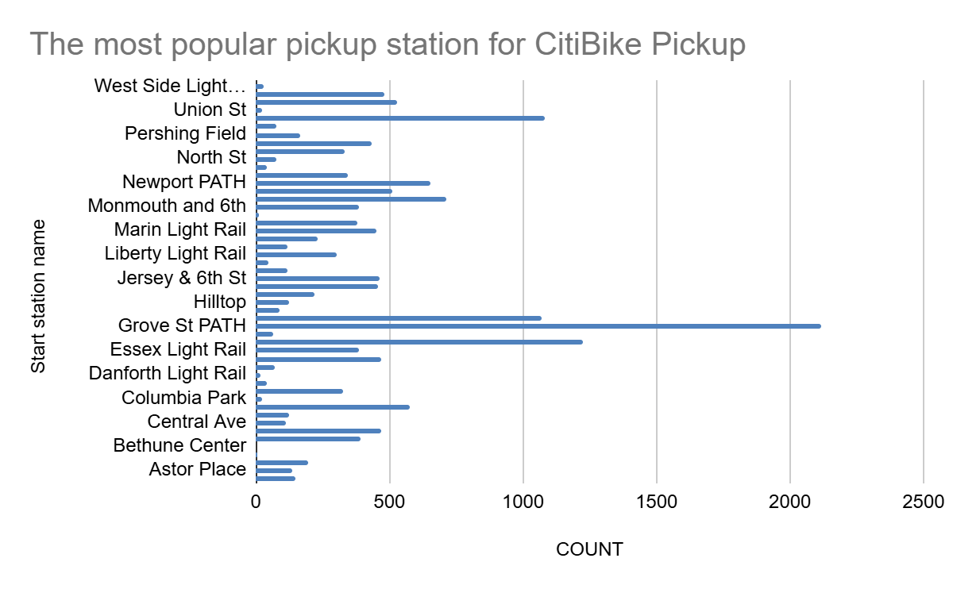
What are the most popular Citi Bike pick-up locations?

Slide 6
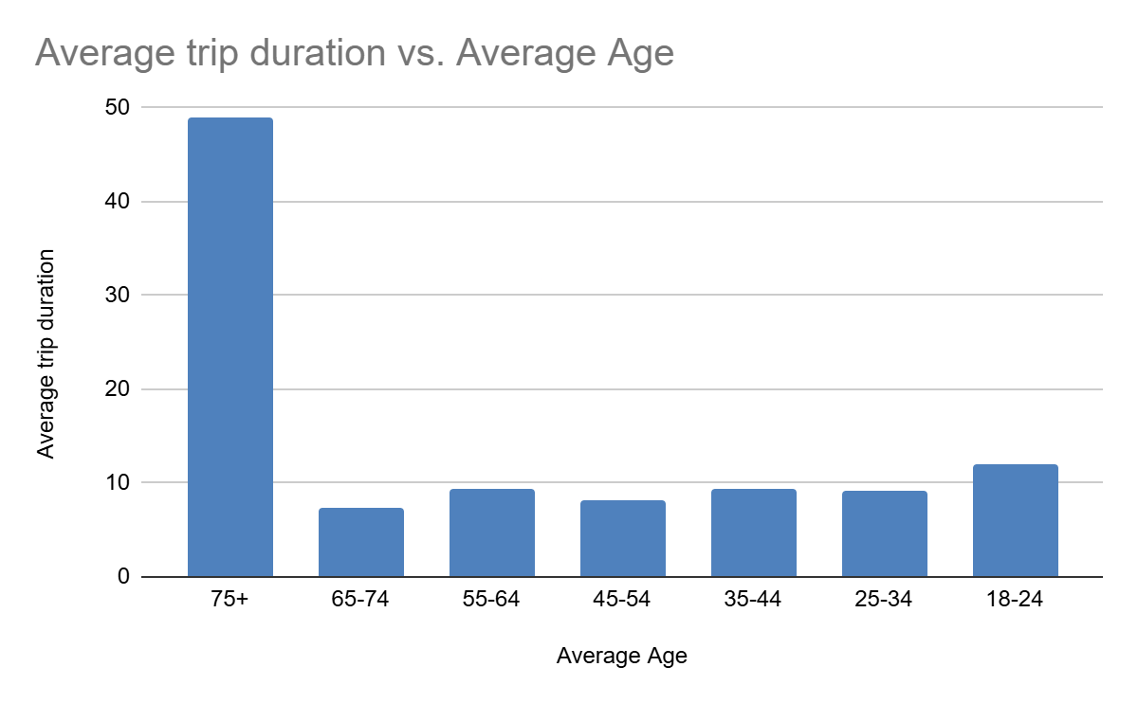
2. How does the average trip duration vary across different age groups?
The Average trip duration of the different age groups where the 65+ age groups has the highest average duration which ranges till 48 mins.

Slide 7
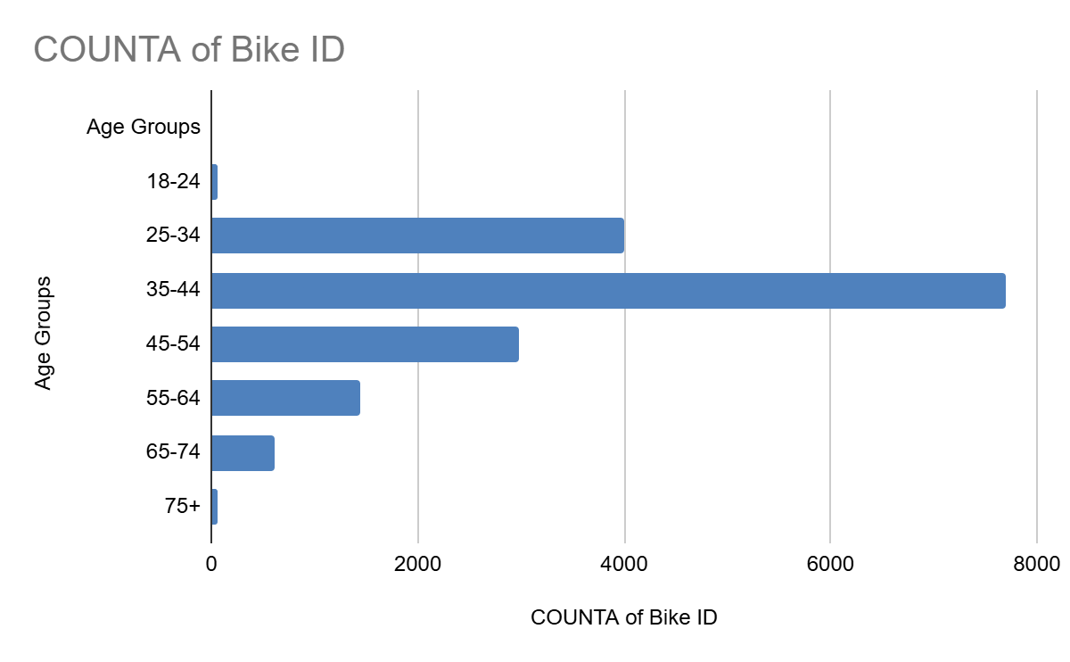
3. Which age group rents the most bikes?
The age group between 35-44 rents the bike mostly compared to the other groups followed by 25-34 age groups. The highest number ranges around 7600 and the least number is 50-100 for age groups for 18-24 and 75+.

Slide 8
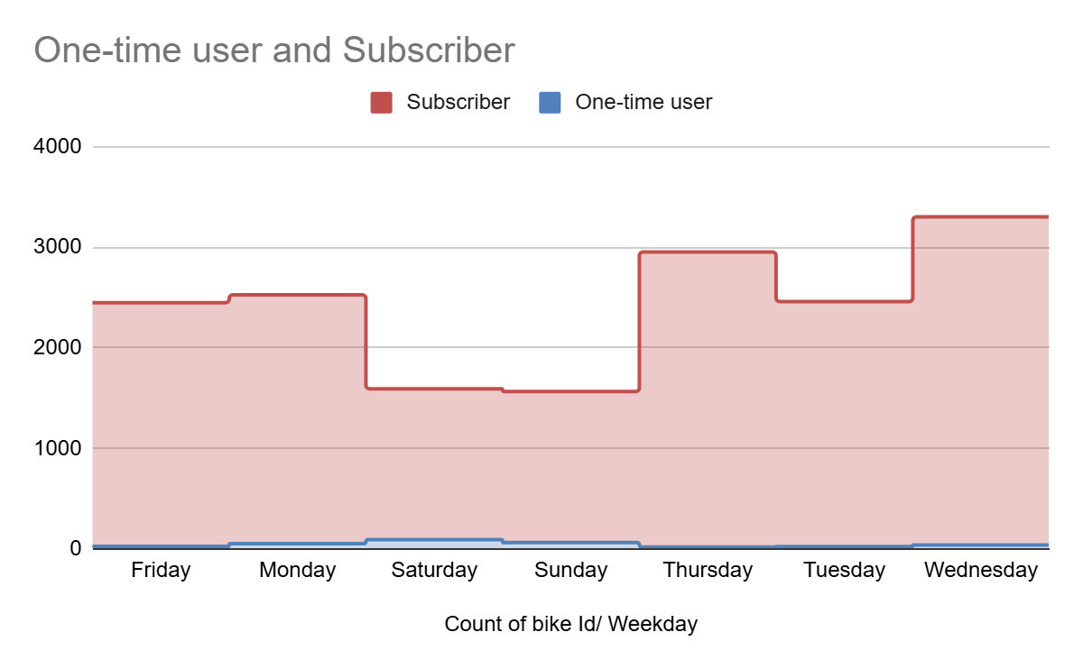
4. How does bike rental vary across the two user groups (one-time users vs long-term subscribers) on different days of the week?
The subscribers are more in number compared to one-time user and the one-time users usually rents the bike during weekends.

Slide 9
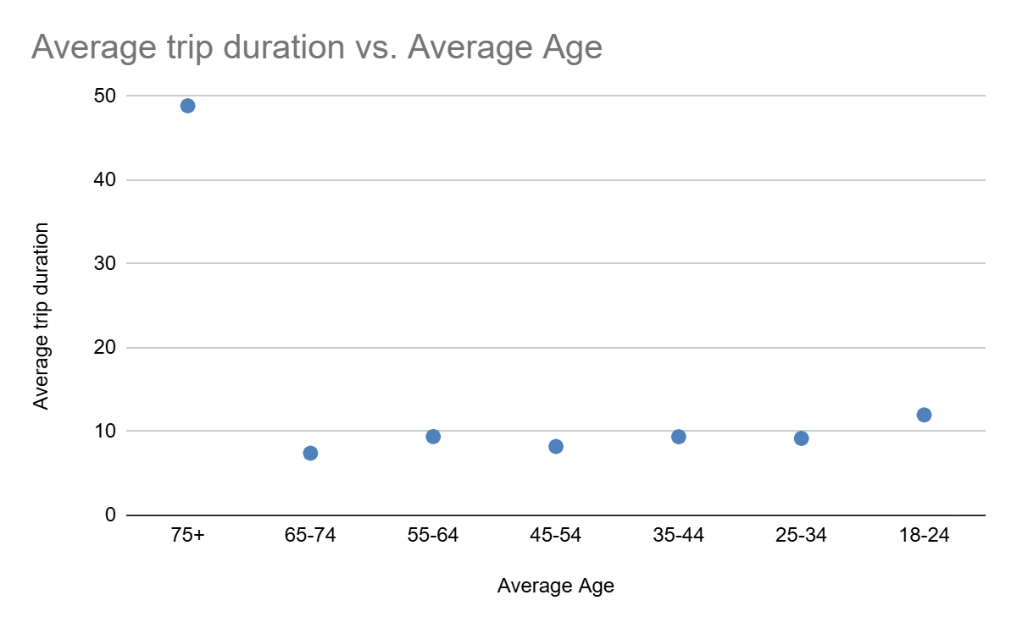
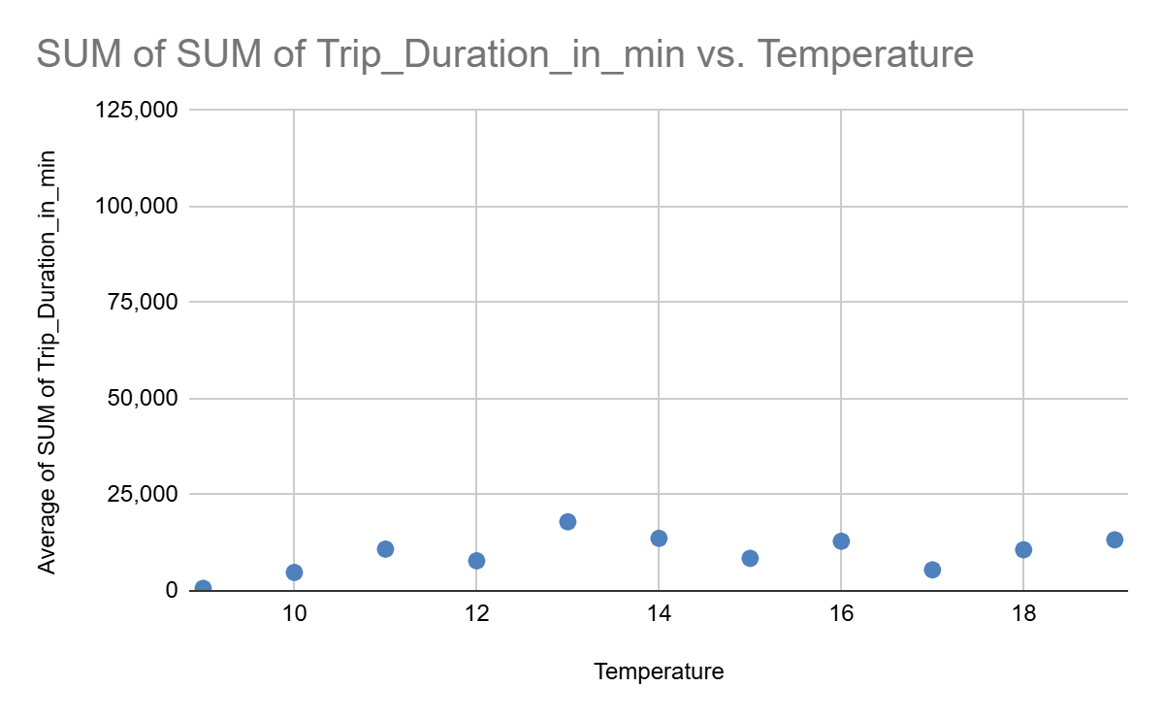
5. Do factors like weather and age impact the average bike trip duration?
The average age duration does not impact the trip duration but the weather does impact

Slide 10
Summary
The most popular pickup location:Grove St Path
The Age group who rents most: 35-44
The Age groups who rents the least: 65+
It has more users who are subscribed.

Slide 11
Summary of findings:
Top 5 pick-up locations for bikes:
Grove St Path, Exchange Place, Sip Ave, Hamilton Park, & Morris Canal
Customer base:
The CitiBike has a wide range of customers ranging from 18 to 65 age groups but the most who rents the bike are the age groups who are at their midage and are the main person who in general may earn bread.
The lowest number can be seen during the age groups of 18-24 and 65+ leasts rents the bike.
It can be also observed that the subscriber are the highest in number and who rents the bike during weekdays, from which it can be made out that they may use that the bike for official use.
Citi Bike customer behavior:
The age groups above 65+ are the mostly to have more average trip duration followed by the age groups 18-24.
But the age groups 34-44 are the ones who rents the car at most.

Slide 12
Actions & Recommendations

Slide 13
Recommended actions:
Product recommendations:
Install more bikes at the areas where the residential areas are nearer to the corporate or the offices, since we can see that the age groups who rents the car are the age groups between 34-44.
Marketing recommendations:
The CitiBike customer base is mostly subscribed users aged between 34-44, who are most active weekday. This tells us that they are probably people who live in New York and use Citi Bikes to commute. Marketing and advertising campaigns should therefore target this particular demographic.

Slide 14
Thank you!

